Slide 1
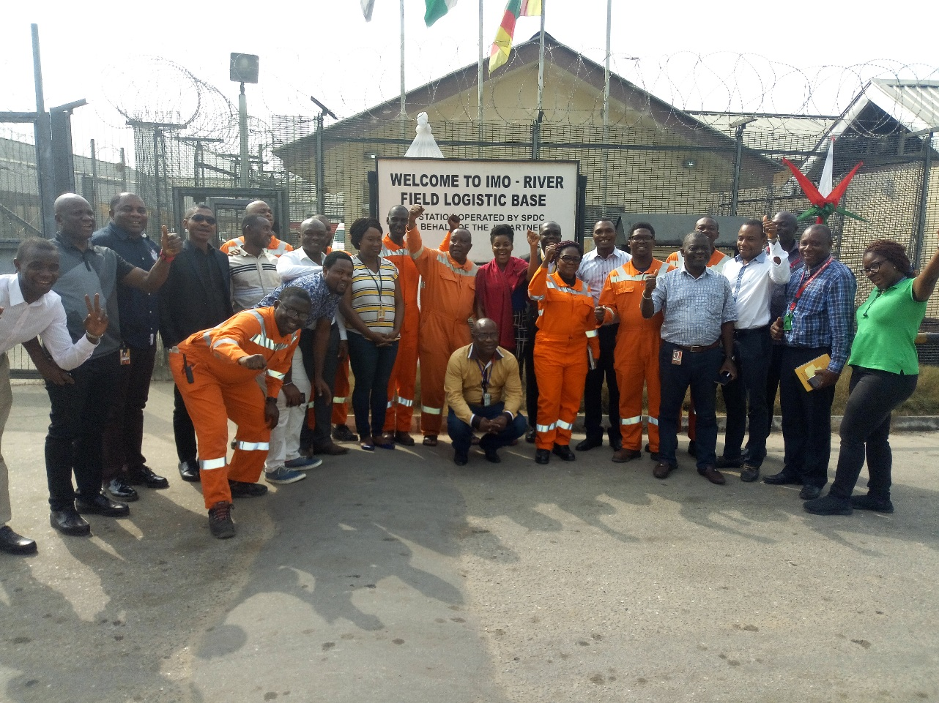
2018 IMO RIVER STRATEGIC PLANNING WORKSHOP Report out

Slide 2



GOAL ZERO/MOTIVATED PEOPLE
Measure | Plan
12 | As per PUM MFE plan
15 | As per PUM HSE Drill Plan
24 | 1 per crew/month
8 | Mar-18 | Jun-18 | Sep-18 | Nov-18
2 | Jun-18 |  | Nov-18
4 | Mar-18 | Jun-18 | Sep-18 | Nov-18
48 | Mar-18 | Jun-18 | Sep-18 | Nov-18
25 | Daily UA/UC Review
4 | Mar-18 | Jun-18 | Sep-18 | Dec-18
< 10% | Monthly Closed Actions Review
PUM/TL MFEs
HSE Drills
DFA Club Meetings
Health Walks
Safety Leadership
Investment/ HR Awareness
LFI Cascades
Daily UA/UC Reporting
UA/UC Reporting Awards
UA/UC Closed Actions

Slide 3
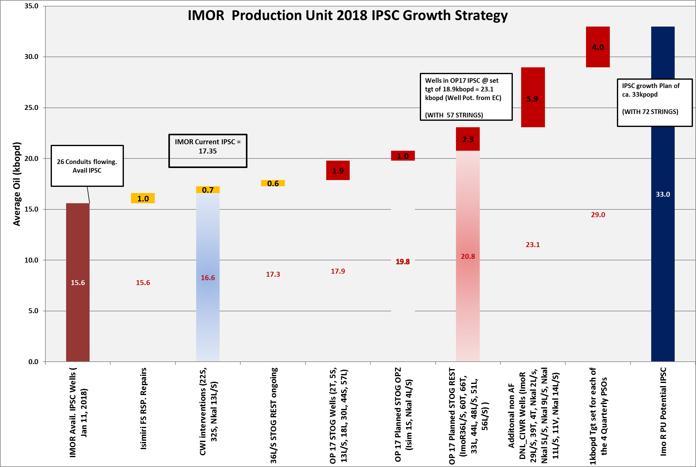
IPSC GROWTH PLAN AND ENABLERS
OP17 IPSC target 18.9 kbopd annualized.
OP17 IPSC plans peaks at 20.3 kbopd in Dec. ‘18.
ImoR PU Current IPSC 17.3kbopd
WRFM restoration and optimization activities with additional 5.8kbopd
Total CIWR signed off proposals Non AF = 6.1kbopd.
Target 1kbopd for Quarterly PSOs
IMOR PU Gas lift revamp and optimization
OP17 IPSC 18.9 kbopd
BP17 Tgt.. 13.9 kbopd
Source: ImoR PU strategy workshop, Wells potential EC rates, OP 17 conduits plan and WRFM 2018

Slide 4
COST OPTIMISATION ROADMAP
S/N | Opportunities | 2017 YTD Actual $ | OP 17 Budget $ | Cost reduction Ambition $
1 | 3rd party PMs | 864,112 | - | 216,028
2 | Catering | 456,868 | 465,725 | 45,686
3 | Imor 2 facility operations | 391,078 | 324,589 | 162,294
4 | Repairs | 344,099 | 676,546 | 338,273
5 | Lubricants | 266,783 | - | 26,678
6 | Chemicals | 240,177 | - | 48,035
7 | Diesel | 130,465 | - | 52,186
Total Cost Savings |  |  |  | 889,180

Slide 5
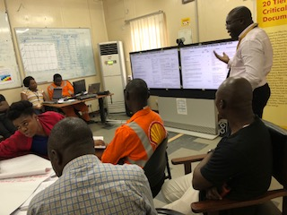
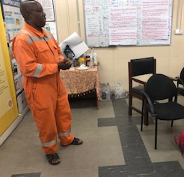
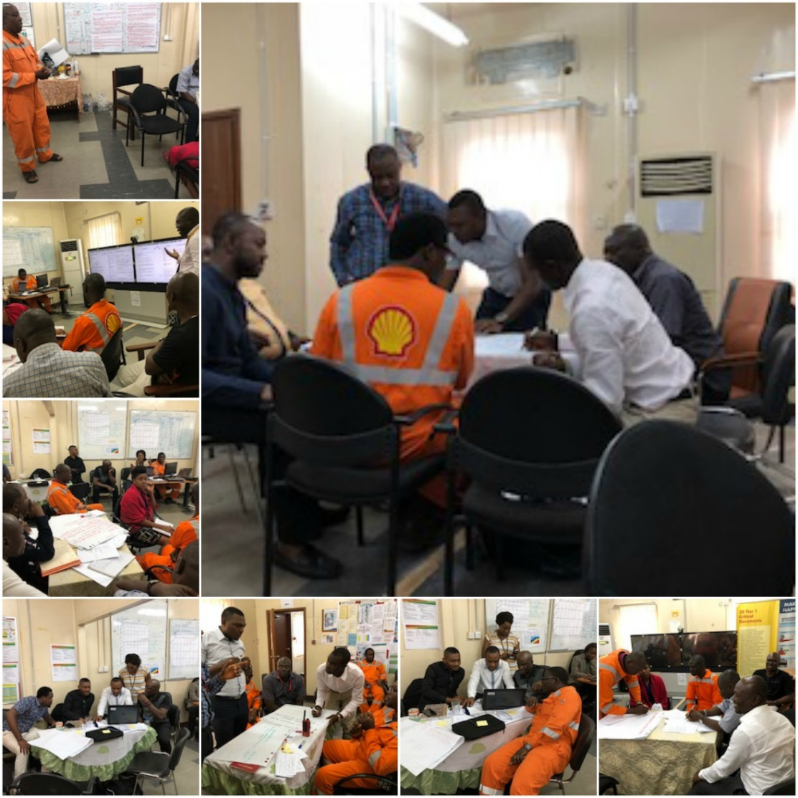
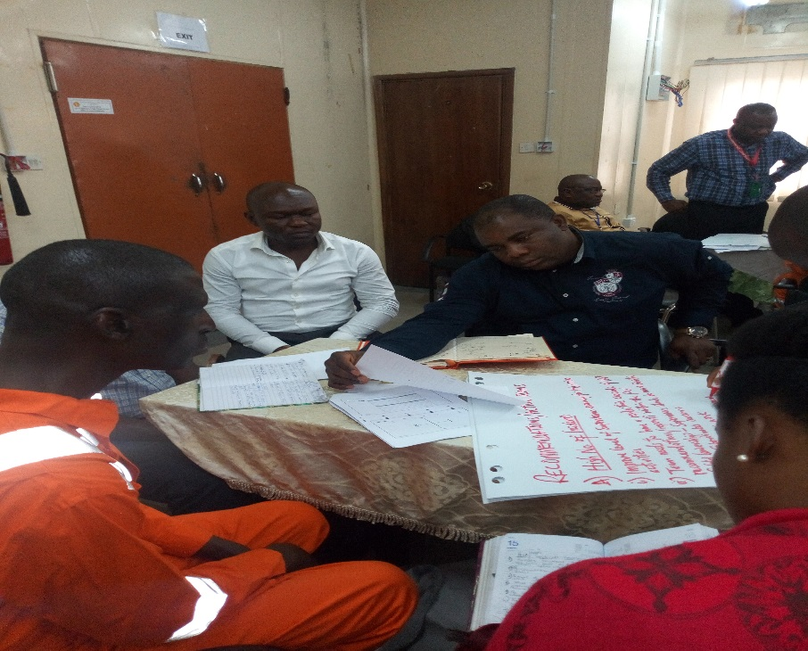
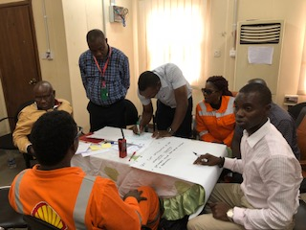
Thank You!

Slide 7
HSSE/PEOPLE SYNDICATE
PEOPLE
 | Opportunity | Current Challenges | Recommendations/Improvement Plan | Timeline | Action Party
1 | Staff Salary/Contract | * Staff salaries owed/not paid timely * Contracts expire/ renewal not initiated early | *Identification of all Contract Holders/ Visibility to OH & HSE departments * Organize Contract Holder Training * Contractor Performance/ Tracking ; blacklisting under-performing contractors | Q2 2018 | C&P/PUM
2 | Rewards/Recognition Framework | Staff contributions not adequately rewarded | * PU to establish a Reward/Recognition Framework * Redefine existing rewards & recognition scheme | Q1 2018 | PUM
3 | Family Concept | Staff feel an absence of care/sense of belonging | Initiate programs/events that bring about a sense of oneness | Q2 2018 | Welfare Committee
4 | Succession Planning | No clear succession plan in PU for all roles | Team to develop succession plan | Q1 2018 | PUM
5 | Personnel Development | Staff lacking knowledge in pursuits outside core discipline | Initiate knowledge sharing sessions for staff on different topics e.g Agro-allied, Finance, business, cross-learning e.t.c | Q1 2018 | Welfare Committee
6 | External Placements | Staff feel redundant and need new challenges | Team Leadership to actively search for other opportunities for growth within the company for staff | Q3 2018 | PUM

Slide 8
HSSE/PEOPLE SYNDICATE2
PEOPLE
 | Opportunity | Current Challenges | Recommendations/Improvement Plan | Timeline | Action Party
1 | Staff Salary/Contract | * Staff salaries owed/not paid timely * Contracts expire/ renewal not initiated early | *Identification of all Contract Holders/ Visibility to OH & HSE departments * Organize Contract Holder Training * Contractor Performance/ Tracking ; blacklisting under-performing contractors | Q2 2018 | C&P/PUM
2 | Rewards/Recognition Framework | Staff contributions not adequately rewarded | * PU to establish a Reward/Recognition Framework * Redefine existing rewards & recognition scheme | Q1 2018 | PUM
3 | Family Concept | Staff feel an absence of care/sense of belonging | Initiate programs/events that bring about a sense of oneness | Q2 2018 | Welfare Committee
4 | Succession Planning | No clear succession plan in PU for all roles | Team to develop succession plan | Q1 2018 | PUM
5 | Personnel Development | Staff lacking knowledge in pursuits outside core discipline | Initiate knowledge sharing sessions for staff on different topics e.g Agro-allied, Finance, business, cross-learning e.t.c | Q1 2018 | Welfare Committee
6 | External Placements | Staff feel redundant and need new challenges | Team Leadership to actively search for other opportunities for growth within the company for staff | Q3 2018 | PUM

Slide 9
PRODUCTION ENHANCEMENT SYNDICATE REPORT
 | Opportunities | Reward |  | Challenges |  | Recommendation/Improvement Plan | Action Party
 |  | Oil kbopd | Gas MMscf |  | Cost
1 | Grow Oil production IPSC from 16.6 to 25 kbopd by Restoration of production from CWI & Asset Eng’g interventions, Wells with signed off proposals and AG Dom gas export by ca 20 MMscf AF = 2.5kbopd Assured Opportunities = 6.2 kbopd | 8.7 | TBD | * Funding *Execution of some of the opportunities such as workovers * Resources to carry out scope revalidation * CO2 issues from restoration candidates in Nkali | WIP | * Asset management to resolve funding * Development and operations to confirm resource availability * Manage CO2 from Nkali - sweetening/blending DNL AND OPS TO fast-track the review and scope-revalidation | * AMIL * DNL/WRFM * PROCESS/OPS
2 | Gas lift Optimization/ Revamping with ca 2 kbopd potential addition | 2 | TBD | *Funding * Resources to carry out scope revalidation | WIP | * Asset management to resolve funding * Development and operations to confirm resource availability | * AMIL * DNL/WRFM * PROCESS / OPS
3 | Improve availability from ca 61% to 76% through enhanced production equipment availability and AGG enhanced capacity utilization | - | - | 1 Availability of Solar FSR 2. Availability of critical spares 3. Power Generation | WIP | 1. Posibility of making FSRs Resident on Site 2. C&P Deliverying on promise and PO tracking post issue 3. a. Effective maintenance & enchanced problem solving. 3. Generator shelf life checks | * PRODUCTION SVC MGR * C&P * AMIL
4 | Reduce oil theft and improve export availability by latching unto GMOU surveillance aggrement by pipeline asset from the current CAST strategy | TBD | TBD | Contractor inerface management | WIP | change from CAST to GMOU surveillance contracts | * PIPELINES
5 | Improve reconciliation factor by 24% through enhanced BSW monitoring / surveillance, and monthly metering revalidation | 4.1 | - | * Resources, logistics and security to carry frequent monitoring * No real time monitoring, especially for the remote stations. | WIP | * Installation of RTO systems on wells and facilities, especially with improved surveillance in place | * PROGRAMMING / ROCI
6 | Opportunity to export gas from IMOR/Interfield nework to AFAM power plant to compliment okoloma and improve availability | TBD | 30 (from all 3 fields) | * Supply line belongs to NGC. * Commercial intervention required to confirm reversibility of the Check valve on the pipeline | WIP | Carry out Feasibility and study on reversibility of check valve on gas export pipeline . Scope and execute | * GAS COMMERCIAL * PROCESS
7 | Gains from Quarterly PSOs | 4 | - | * Improved participation/ Ownership of actions | WIP | * Proactive booking of calendars for the year. * PSO to be adopted as part of the critical operation meeting for FFF program for SPDC | * DNL/ WRFM/ OPS/ AMIL

Slide 10
COST OPTIMISATION SYNDICATE REPORT OUT
 | Opportunities | Reward –Oil (Kboepd) | Challenges | Cost $ | Recommendation/Improvement Plan | Action Party
1 | Optimized value from services, contracts & personnel | TBD | *Manpower challenges *Biggest cost area requiring asset to ensure it derives more value for cost incurred *Re-allocation of common costs | - | 1)Explore opportunities of optimizing Wellhead surveillance contracts and Personnel support contracts (E.g.. giving station attendants more responsibilities in supporting manpower such as ad-hoc maintenance and operations within their contracts) 2)Revise scope and frequency of service contracts to Optimize cost | PUM
2 | Reduce spend on 3rd party PMs | TBD | *High costs associated with flowline inspection, facility painting and other condition monitoring activities *Multiple similar/related 3rd party maintenance activities carried out by different teams(e.g. FIMS and Maintenance Execution) | 216,028 | 1)Challenge and scrutinize all costs for maintenance related activities as well as critique cost along with finance team, prior to it hitting our books 2) Explore and engage TAs on use of RBI and on-spot repairs for maintenance of flowline inspections, UT and facility painting/corrosion assessments (C&I team and Asset) 3) Discuss integration of the execution of some 3rd party activities to optimize cost e.g. flowline and facility piping in plot/on plot piping done by FIMs and maintenance execution etc 4)Articulate resources required to take on more DIY activities by asset personnel. Specifically monthly Meter proving activity | 1) PUM/ Cost focal point 2,3 & 4)MTL
3 | Re-routing projects | TBD | *Project still on-going, gains from re-routing not yet derived and affecting our OP'17 plan | 162,294 | Obtain new schedule for Imo 2 and 3 facility re-routing and expedite completion of project. To enable realization of maintenance/logistic/operations cost from running the facilities. | PUM Asset Engineering
4 | Equipment repairs optimization | TBD | *High cost from corrective maintenance activities *Shortage of manpower for executing maintenance activities *Long lead time for equipment repairs and return *unavailability of spares and obsolescence of equipment | 338,273 | 1) Improve relationship with maintenance execution. Determine and agree list of maintenance activities requiring support where maintenance execution can help execute at zero to very little cost 2)Optimise scheduling of 3rd party activities to minimize impact on costs and facility availability. Get list of all 3rd party maintenance activities for the year and create plan to minimize downtime of the facility 3)Improve turnaround time for repair of production critical equipment such as generators, electric motors etc. By having a single focal point to expedite and follow -up on repairs at the workshop (MTL and Maintenance Execution) 4)Institute structure around critical spares and obsolescence management. (Develop a list of items/critical spares with the average market price to serve as a basis for cost challenges - Cost estimation team in-house) | 1,2,3)MTL & Maintenance Execution 4)MTL/Cost focal point
5 | Lubricants, chemicals & diesel | TBD | *High rate of lubricant & chemical usage *High diesel consumption rate and associated cost | 126,899 | 1)Draw up and implement AGG availability and gas utilization Improvement plan(To ensure reduction in usage of diesel) 2)Set-up monitoring program for diesel and chemical consumption(e.g. Standing Instructions for issuing etc) 3)Institute process check around use of lubricants, chemicals etc. Daily consumption stock reports and chemical management sheet. | 1)MTL 2) Scheduler 3)PUM
6 | Catering | TBD | *High catering costs | 45,686 | Increase scrutiny around ensuring charge-backs done are effected | Cost focal point

Slide 11
IMO PU PUM MFE PLAN FOR 2018
MONTH | IMOR 1 | NKALI | IMOR 2 | IMOR 3 | IMOR AGG | IMOR FLB | ISIMIRI
JANUARY | WK 2
FEBRUARY |  | WK 1
MARCH |  |  | WK 2
APRIL |  |  |  | WK 3
MAY |  |  |  |  | WK 1
JUNE |  |  |  |  |  | WK 3
JULY |  |  |  |  |  |  | WK 4
AUGUST | WK 4
SEPTEMBER |  |  |  | WK 1
OCTOBER |  |  |  |  |  |  | WK 2
NOVEMBER |  |  |  |  | WK 2
DECEMBER |  |  |  |  |  | WK 3

Slide 12
IMO PU PUM DRILL PLAN FOR 2018
IMO RIVER PU EMERGENCY RESPONSE DRILL PLAN FOR 2018
FACILITY | JAN | FEB | MAR | APR | MAY | JUN | JUL | AUG | SEPT | OCT | NOV | DEC
IMOR FOC | Fire drill Wk 1 |  |  |  |  |  | Security Drill Wk 3 |  |  | Gas leak Drill Wk4
IMOR 1 |  |  | Oil spill Drill Wk4 |  |  |  |  |  | Chemical Spill Drill Wk 2
IMOR 2 |  |  |  |  | Fire drill Wk 1 |  |  |  |  |  |  | Fire drill wk 3
IMOR 3 |  | Medavac Drill wk1 |  |  |  | Oil spill Drill Wk4
IMOR AGG | Chemical Spill Drill wk 3 |  |  |  |  |  |  | Gas leak Drill Wk3
NKALI |  | Fire Drill wk 3 |  | Security Drill Wk 2
ISIMIRI |  |  |  |  | Gas leak Drill Wk4 |  |  |  |  |  | Medevac Drill Wk 3

Slide 13
WRFM ImoR PU 2018
2018 IPSC Target 18.922 kbopd
1.6 kbopd
35%
3%
2018 Production Target 13.973 kbopd
24%

Slide 14
Dec 2017 Imor PU Deferment Vs IPSC Growth – by Process eqpt./ Owner

Slide 15
2018 Imor PU Non-AF STOG Opportunities for IPSC

Slide 16
IPSC GROWTH PLAN AND ENABLERS
Source: ImoR PU strategy workshop, Wells potential BI rates and WRFM 2018

Slide 17
WORKBOOK INSERT

